Slide 1

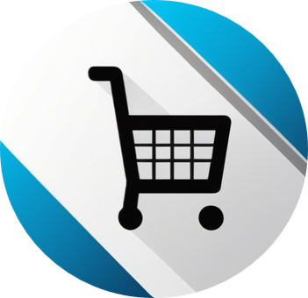
OmniMart Pvt Ltd.
Omnichannel Retail Behavior and Performance Analytics Dashboard
Analysis Period: March 2020 - March 2025
By - Sudhagar Lakshmanan | Business Intelligence Engineer

Slide 2

Table of Content (Click Hyperlink texts below to explore the destination)
Executive Summary | 3
Data Source and Processing | 4
Workflow and Approach | 5
Tools Used | 6
Key Insights | 7
Revenue Insights | 8
Product Insights | 9
Customer Insights | 10
Campaigns Insights | 11
Support Tickets Insights | 12
Recommendations - Revenue , Product | 13
Recommendations - Customers, Campaigns | 14
Recommendations - Support Tickets | 15
Action Plan | 16
Appendix 1: File Descriptions - Customers, Transactions | 17
Appendix 1: File Descriptions - Interactions, Campaigns | 18
Appendix 1: File Descriptions - Customers Reviews, Support Tickets | 19

Slide 3





Executive Summary
Project Overview
This analysis was conducted as part of a business intelligence initiative to evaluate the Omnichannel retail behavior and performance of a fictional retail brand OmniMart Pvt Ltd over the period March 2020 to March 2025.
The objective was to identify insights and opportunities across five key business areas - Revenue, Products, Customers, Campaigns and Support.
Business Objective
What OmniMart Aims to Achieve with the Power BI Dashboard ?
Accelerate Decision-Making Deliver real-time, actionable insights to decision-makers across sales, marketing and support functions.
Unify Omnichannel Performance Visibility Integrate sales, customer, campaign and support data from offline and online channels into one platform.
Enhance Customer Engagement & Retention Track churn, campaign responses and SLA metric, CSS to improve satisfaction and loyalty.
Foster Accountability Through Role-Based Reporting Provide tailored dashboards with access control for executives, managers, analysts and support teams.
Support Operational Efficiency and Data Trust Replace manual reports with automated, validated dashboards powered by SQL and Power BI.

Slide 4




Data Source and Processing
About the Source
The dataset was sourced from Kaggle website, a popular platform for hosting datasets.
Kaggle hosts a wide range of community-contributed datasets, making it a valuable resource for analysis projects.
This dataset contains fictional or sample retail data gathered from various sources within a retail business environment.
Description of the Dataset
(Click Hyperlink texts below to know more)
Source: Kaggle - 🔗 Retail Customer & Transaction Dataset
Period Covered: March 2020 - March 2025
Files Used:
🔗 Customers
🔗 Transactions
🔗 Interactions
🔗 Campaigns
🔗 Customer reviews
🔗 Support tickets
Data Preparation & Processing
Verified file structures and column definitions in Excel.
Checked quality: minor missing values (e.g., phone, discounts), assumed all amounts in USD.
Imported datasets into MySQL for structured cleaning and transformation.
Data Cleaning
Fixed missing values (dates, budget, ratings, product names).
Removed duplicates (customer_id, emails).
Validated formats (emails, phone numbers, names).
Flagged orphan records; identified outliers in age, prices, satisfaction scores.
Standardized store location (City/State).
Standardized categorical values (e.g., store location formats).
Recalculated and validated campaign KPIs.

Slide 5




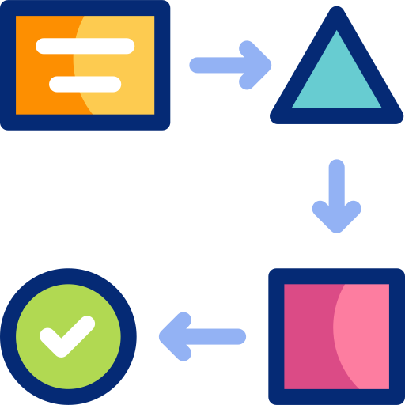

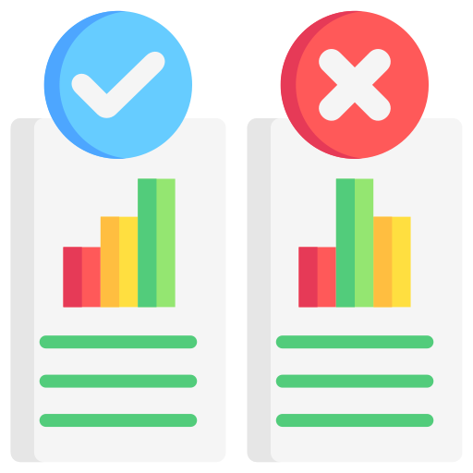
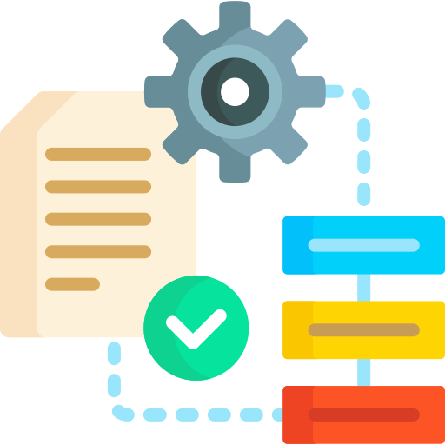

Workflow and Approach
1. Requirement Gathering
Created sample ‘Business Request Email’ format to identify reporting needs.
2. Business Requirement Document (BRD)
Documented objectives, scope, KPIs, functional/non-functional requirements, success criteria, gap analysis.
Created User Stories and Use Cases.
3. Process Mapping
Designed current state and future state process flows using Lucidchart.
4. Wireframes & Layout Planning
Built interactive dashboard wireframes in Balsamiq (summary, overview, revenue, products, customers, campaigns, support tickets).
5. Analysis Question Framework
Developed 26 key analysis questions covering revenue, products, customers, campaigns and support operations to guide SQL development.
6. Data Preparation (see “Data Source” slide for details)
Performed data cleaning, transformation and validation from multiple CSV files.
7. SQL Development
Wrote 26 targeted SQL queries aligned with the analysis questions and KPIs.
8. Power BI Dashboard Development
Imported cleaned datasets and applied data modelling best practices.
Created DAX measures for KPIs and custom calculations.
Designed interactive filters, slicers and drill-throughs.
Applied conditional formatting and visual-level filters to highlight trends.
9. UAT (User Acceptance Testing)
Created UAT plan, test cases, defect tracker, traceability matrix and sign-off.
10. Delivery
Delivered final dashboard/report with supporting documentation.

Slide 6





Tools Used
Data Storage & Processing
MySQL - Structured database creation, SQL-based cleaning, transformations and KPI mapping.
Excel - Initial column verification, quick data quality checks and exploratory profiling.
Wireframing & Design
Balsamiq - Created low-fidelity dashboard wireframes for Summary, Overview, Revenue, Products, Customers, Campaigns and Support pages.
Process Modelling
Lucidchart - Designed Current-state (As-is) and Future-state (To-be) process flow diagrams to visualize reporting workflows.
Data Visualization & Reporting
Power BI - Built interactive dashboards, applied DAX measures and developed page-level KPIs with slicers/filters for drill-downs.
Documentation
MS Word - Sample Business Request Email, Business Requirements Document (BRD)
MS Excel - UAT plans, Test Cases, Defect Tracking.
MS PowerPoint - Executive presentation of insights and recommendations.

Slide 7
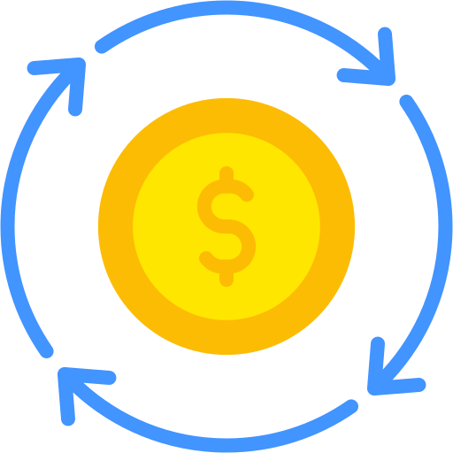





Key Insights
Overview
Gross Revenue before discounts was $27.79M, with total discounts reducing it by $0.24M, resulting in a net revenue of $27.55M
Net revenue generated is $27.55M, with 'Furniture' category contributing the highest share of $6.1M
'Google Nest' is the best-selling item with 1,359 units sold, while 'Sheets' leads in quality with an average rating of 5.0
'California' state leads with the highest customer base of 873 individuals out of 5,000 total customers
'Search Engine Marketing' campaigns delivered the highest ROI of $162.64k, with top performance seen in the 'Home Improvement' audience segment
'Shipping' was the most reported issue type, with 436 tickets raised, 379 of them were resolved, averaging 37.67 hours to close and a customer satisfaction score of 3.52

Slide 8







Revenue Insights | Where the Money Flows
Overall
Gross Revenue - $27.79M
Net Revenue - $27.55M
Discounts Applied - $240.77K
Discount Margin - 0.87%, indicating a value-preserving pricing strategy rather than heavy discounting
Net Revenue Trends Over Time
Strong YoY growth from 2020 to 2024, driven by post-COVID recovery and digital expansion
Revenue growth peaked at +231% in 2021
The -87% dip in 2025 is due to partial-year data (Jan-Mar) and is not reflective of performance decline
Seasonal Sales Highlights
Peak sales months were November $3.71M and December $3.79M, highlighting strong holiday seasonality.
Top Payment Channel
‘Credit Card’ was the leading method
Revenue - $9.38M
Transactions - 10,907
Revenue by Channel & State
Online Channel
Revenue - $13.97M
5× higher than any single physical region
California
Revenue - $2.66M
Top Performing Region
Top Product Categories by Revenue
Furniture - $6.13M
Smartphones - $4.94M
Laptops - $3.94M
TVs - $3.25M
Kitchen Appliances - $2.91M
Best-Selling Individual Products
Bed Frame - $1.37M
Office Desk - $1.22M
Sofa - $1.21M
Bookshelf - $1.21M
Dining Table - $1.08M

Slide 9



Products Insights | What People Bought
Overall
Total Units Sold - 45,532
Average Product Rating - 4.0
Avg Product Ratings High Rated Products
5.0 Rating - iMac, Lenovo IdeaCentre, Lenovo Tab, Sheets
4.7 Rating - Baking Sheet, Cookware Set
4.5 Rating - Amazon Fire HD
Low Rated Products
3.0 Rating – Knife Set
2.5 Rating - Cast Iron Skillet
2.0 Rating - Logitech Mouse
Best-Selling Product Categories
Smart Home Devices - 6,153 units
Smartphones - 6,153 units
Furniture - 5,575 units
Home Decor - 5,349 units
Kitchen Appliances - 5,255 units
Top 10 Products by Quantity Sold
Google Nest - 1,359 units
Xiaomi Mi 12 - 1,301 units
Philips Hue - 1,272 units
iPhone 13 - 1,257 units
OnePlus 10 - 1,242 units
Google Pixel 6 - 1,228 units
Amazon Echo - 1,217 units
Throw Pillows - 1,195 units
Smart Thermostat - 1,186 units
Bed Frame - 1,167 units
Revenue vs Discount
Furniture and Smartphones yielded top revenue despite heavier discounts.
Categories with higher net revenue tend to tolerate higher discount levels
First-Time Buyer Counts by Product Category
Smartphones - 608 buyers
Smart Home Devices - 600 buyers
Kitchen Appliances - 529 buyers
Furniture - 517 buyers

Slide 10


Customers Insights | Who They Are
Overall
Total Customers - 5,000
Total Active Customers - 4,618
Customer Retention Rate - 27.86%
Customer Churn Rate (6 months) - 28.60% (1,430 customers), mostly aged 36-50 and 18-25
Repeat Customers Count
Repeat Purchase Rate - 83.94%
Preferred Channels:
Online - 2,056
Both Online & In-store - 1,271
In-store only - 775
Unknown - 95
Top 3 Customers by Revenue
Tracey Patterson - California - $1.44M
Margaret Liu - Pennsylvania - $1.15M
Bethany Cowan - California - $1.06M
Top States by Customers & Revenue
California -
873 customers | $5.07M revenue | Avg Order - $888
Texas - 644 customers | $3.57M revenue | Avg Order - $863
Florida - 542 customers | $2.98M revenue | Avg Order - $852
New York - 469 customers | $2.60M revenue | Avg Order - $863
Top Spend by Age & Gender
Top Spending Segments
Female (36-50) - $5.23M
Male (36-50) - $5.16M
Male (26-35) - $4.27M
Female (26-35) - $4.12M
Non-binary and other categories showed lower spend but consistent participation across age groups

Slide 11




Campaigns Insights | How We Reached Them
Campaign Performance by Type
Search Engine Marketing performs best
ROI - $162.64K
Conversion Rate - 10.45%
Cost Per Click - $0.38
Cost Per Acquisition - $3.67
In-Store Promotions show strong results
ROI - $48.63K,
Conversion Rate - 29.05%
Underperforming campaigns
TV, Radio and Print Ads deliver low ROI under 1% with very high acquisition costs
SMS and Influencer Marketing also have low ROI
Channel Engagement Insights
Highest user interactions from Web with 55.7K and Mobile App with 26.9K
Longest average session durations on Web at 91.08 minutes, followed by Mobile App at 82.49 minutes
Mobile App drove the highest purchase actions at 13.6K
Overall
Total ROI achieved - $296.86K
Overall conversion rate stands at 6.17%
Peak Hours for Purchase Activity
Purchases steadily increase starting from 5 AM
Peak hours are from 11 AM to 2 PM, with the highest volume at 12 PM with 829 purchases
Activity declines after 4 PM, with a small spike at 11 PM
Top ROI-Efficient Target Segments
“Home Improvement” leads with $59.09K ROI
“All Customers” generate $48.72K ROI
Other strong segments include New Customers, West Coast, Middle-aged 41-60 and Southern States generated more than $15k each.

Slide 12
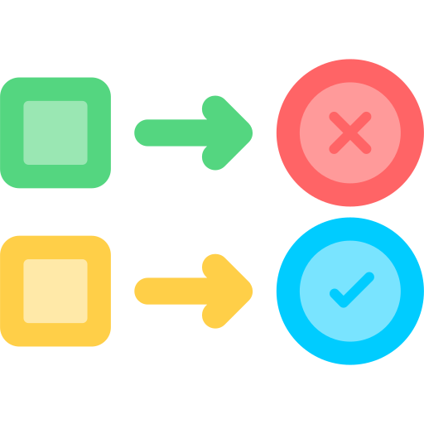

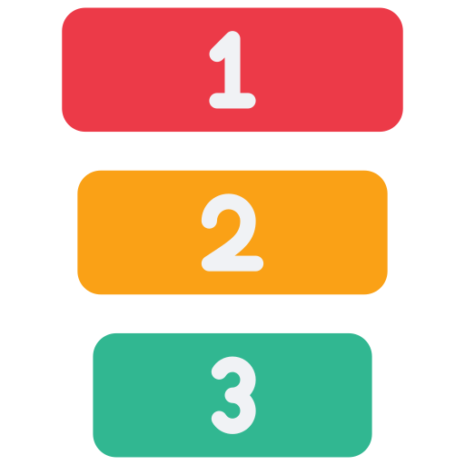


Support Tickets Insights | How We Served Them
Overall
3,000 total tickets handled.
Average Customer Satisfaction Score - 3.44
Ticket volume has grown steadily, peaking at 220+ in Jan 2025.
1 in 3 tickets took more than 48 hours to resolve - area for improvement.
Improve handling of “Account, Product Inquiry issues”.
Monthly Trends
Steady growth in support volume over 5 years.
No major drop in customer satisfaction despite rising ticket load.
Recent months (2024 - 2025) handled 100+ tickets/month with stable CSS score.
Resolution Time Distribution
28.39% of tickets resolved within 24 hours.
0 - 12 hrs - 628 tickets
12 - 24 hrs - 392 tickets
71.61% of tickets took more than 24 hours to resolve.
24 - 48 hrs - 971 tickets
48+ hrs - 1,009 tickets
Ticket Status Overview
Priority-Based Performance
Top Issue Categories
Shipping: Tickets - 436 | Avg Res Hrs - 37.7 | Avg CSS - 3.52
Account: Tickets - 430 | Avg Res Hrs - 51.1| Avg CSS - 3.29
Billing: Tickets - 424 | Avg Res Hrs - 33.6 | Avg CSS - 3.51
Technical: Tickets - 419 | Avg Res Hrs - 33.15 | Avg CSS - 3.45
Status | Total Tickets | Avg Resolution Hrs | Avg CS Score
Resolved | 2652 | 43.58 | 3.48
Pending | 151 | N/A | N/A
Escalated | 86 | N/A | N/A
Unknown | 57 | 32.68 | 3.29
Closed without Resolution | 54 | 124.00 | 1.89
Priority | Total Tickets | Avg Resolution Hrs | Avg CS Score
High | 767 | 24.32 | 3.48
Medium | 1328 | 35.80 | 3.55
Low | 845 | 65.35 | 3.20
Unknown | 60 | 45.48 | 3.83

Slide 13

Recommendations
1. Revenue
Focus marketing efforts on high-revenue categories like Furniture ($6.13M), Smartphones ($4.94M) and Laptops ($3.95M).
Capitalize on Nov ($3.71M) and Dec ($3.78M) surges with festive promotions, bundled deals and upselling.
Optimize ads, personalized recommendations and loyalty rewards to further grow the $13.98M Online revenue channel.
Promote preferred payment methods like Credit Cards ($9.38M across 10,097 transactions) to boost average order value and checkout speed.
Reevaluate low-revenue categories under $500K such as Tablets, Cookware, Small Kitchen Appliances, Bedding and Computer Accessories for promotional pushes.
Develop location-specific offers to lift sales in Florida ($1.19M), Colorado ($1.22M) and similar low-performing states.
2. Product
Increase stock levels by 20% for bestsellers (Bed Frame, Office Desk, Sofa - each $1.2M+) before seasonal peaks.
Expand promoting Smart Home Devices (6,153 units), Smartphones (6,153 units) and Furniture (5,575) with seasonal and event-based campaigns.
Offer retention incentives to first-time buyers in Smartphones (608), Smart Home Devices (600) and Kitchen Appliances (529).
Launch clearance or repositioning strategies for low-volume categories like Bedding, Computer Accessories, Desktop Computers and Tablets.
Pair high-rated products such as iMac (5★) and Lenovo IdeaCentre (5★) with lower-selling items to boost sales.
Highlight 4.5★+ rated products in ads to reinforce trust and improve conversion rate.

Slide 14
Recommendations
3. Customers
Improve the 27.86% retention rate and reduce the 28.6% churn (1,430 in 6 months) by focusing on high-churn age groups 36 - 50 (462 customers) and 26 - 35 (341 customers) through tailored reactivation offers.
Boost lifetime value from top-spending segments: Female 36 - 50 ($5.23M), Male 36 - 50 ($5.16M), and Male 26 - 35 ($4.27M) with premium product bundles, early-bird offers, and loyalty perks.
Leverage online repeat buyers (2,056 customers, 83.94% repeat purchase rate) through loyalty points, early access sales, and subscription models.
Engage top spenders like Tracey Patterson ($1.44M) and Margaret Liu ($1.15M) with exclusive VIP programs to drive advocacy and repeat orders.
Target high-value states California ($5.07M), Texas ($3.57M), Florida ($2.98M) with geo-specific promotions while lifting lower-revenue states like Washington ($0.8M) and Massachusetts ($0.7M).
4. Campaigns
Prioritize Search Engine Marketing (ROI - 32.31%) and Email Marketing (ROI - 15.92%) for future budget allocation, scaling high-ROI channels while reducing spend on low-ROI mediums like TV (0.16%) and Radio (0.34%).
Optimize In-Store Promotions (Conversion Rate - 29.05%) by integrating QR codes and digital coupons to bridge offline-to-online conversions.
Improve underperforming channels (e.g., Online Display ROI 1.13%, Social Media ROI 2.05%) by A/B testing creatives, tightening audience targeting, and leveraging retargeting strategies.
Expand campaigns for Home Improvement (ROI - $59K) while testing niche targeting for high-engagement segments like Technology Enthusiasts and Online Shoppers.
Concentrate ad delivery during peak purchase hours 12 PM - 3 PM and 10 AM - 11 AM when purchase volume exceeds 750 orders/hour.

Slide 15
Recommendations
5. Support Tickets
Ticket volume reached 3,000 in the latest period, with a sharp rise since mid-2023 and a peak of 220 in Jan 2025; capacity scaling is critical.
Yearly trend shows a gradual rise in CS scores until late 2023, then fluctuating between 3.2 - 3.7, signalling stability but no significant improvement.
Only 28.39% of tickets are resolved within 24 hrs, highlighting the need for faster triaging and improved first-contact resolution.
High-priority tickets resolve in 24.32 hrs with a 3.48 CS score, but low-priority ones take 65.35 hrs and yield the lowest CS score (3.20), suggesting disproportionate delays.
Shipping, Account Issues, and Billing each exceed 420 tickets; Account Issues have the longest resolution (51.13 hrs) and below-average satisfaction (3.29).
Website Issues and Product Inquiries average 48+ hrs resolution, indicating system/process inefficiencies in these categories.
“Closed without Resolution” cases take 124 hrs and deliver a poor 1.89 CS score; these should be minimized through escalation protocols.

Slide 16

Action Plan
Implement Targeted Revenue Strategies
Focus on high-performing states like California, Texas, and Florida while running pilot campaigns in underperforming regions to close the gap.
Optimize Product Mix
Increase inventory for top sellers and phase out or repackage low-margin SKUs, using seasonal demand trends to guide planning.
Enhance Customer Segmentation
Launch tailored marketing for high-value segments (e.g., Female 36-50, Male 26-35) while improving engagement for underrepresented demographics.
Refine Campaign Investments
Shift budget toward high-ROI channels such as Search Engine Marketing, Email, and In-Store Promotions, while testing new low-cost digital avenues.
Streamline Support Processes
Address high ticket volumes in categories like Shipping and Account Issues through automation, improved FAQs, and priority-based resolution workflows.

Slide 17
Appendix 1 - File Descriptions
1. Customers:
(Contains demographic, basic registration information about each customer.)
Rows - 5,000 | Columns - 12
Column Details:
Customer ID (int or string): Unique identifier for each customer.
Full Name (string): Full name of the customer.
Age (int): Age of the customer.
Gender (string): Gender of the customer (e.g., “Male”, “Female”, “Other”).
Email (string): Email address.
Phone (string): Phone number.
Street Address (string): Street address.
City (string): City of residence.
State (string): State of residence.
Zip Code (string): Zip code/postal code.
Registration Date (date): Date the customer registered.
Preferred Channel (string): Preferred communication channel (e.g., “Email”, “SMS”, “Phone”).
2. Transactions:
(Includes purchase information for products bought by customers.)
Rows - 32,295 | Columns - 10
Column Details:
Transaction ID (int): Unique ID for each transaction.
Customer ID (int or string): Links to customer id in customers.csv.
Product Name (string): Name of the purchased product.
Product Category (string): Category of the product.
Quantity (int): Number of units purchased in this transaction.
Price (float): Price per unit of the product.
Transaction Date (date): Date when the transaction was completed.
Store Location (string): Physical store location or “Online” if purchased via e-commerce.
Payment Method (string): Payment method (e.g., “Credit Card”, “PayPal”, “Cash”).
Discount Applied (float or int): Discount amount or percentage applied (if any).

Slide 18
Appendix 1 - File Descriptions
3. Interactions:
(Captures various interactions the customer has with the company’s digital channels.)
Rows - 1,00,000 | Columns - 8
Column Details:
Interaction ID (int): Unique ID for each interaction.
Customer ID (int or string): Links to customer id in customers.csv.
Channel (string): Channel of interaction (e.g., “Website”, “Mobile App”, “Social Media”).
Interaction Type (string): Type of interaction (e.g., “View Product”, “Add to Cart”, “Click Ad”).
Interaction Date (date): Date of the interaction.
Duration (int or float): Duration of interaction in seconds or minutes.
Page or Product (string): Page visited or product name related to the interaction.
Session ID (string): Session identifier to track multiple actions within one session.
4. Campaigns:
(Details about marketing or advertising campaigns.)
Rows - 200 | Columns - 12
Column Details:
Campaign ID (int): Unique campaign identifier.
Campaign Name (string): Name or title of the campaign.
Campaign Type (string): Type of campaign (e.g., “Email”, “Social Media”, “TV Ad”).
Start Date (date): Launch date of the campaign.
End Date (date): Completion date of the campaign.
Target Segment (string): Target audience or segment (e.g., “Loyal Customers”, “New Registrations”).
Budget (float): Allocated budget for the campaign.
Impressions (int): Number of impressions generated.
Clicks (int): Number of clicks.
Conversions (int): Number of desired conversions (e.g., sign-ups, purchases).
Conversion rate (float): Percentage of impressions that resulted in conversions.
ROI (float): Return on investment for the campaign.

Slide 19
Appendix 1 - File Descriptions
5. Customer Reviews:
(Collection of product reviews submitted by customers post-purchase.)
Rows - 1,000 | Columns - 10
Column Details:
Review ID (int): Unique identifier for each review.
Customer ID (int or string): Links to customer id in customers.csv.
Product Name (string): Name of the product reviewed.
Product Category (string): Category of the product reviewed.
Full Name (string): Name of the customer (could be anonymized).
Transaction Date (date): Date of the transaction related to this review.
Review Date (date): Date the review was posted.
Rating (int): Rating given by the customer (e.g., 1 to 5 stars).
Review Title (string): Short title or summary of the review.
Review Text (string): Full text of the customer’s review.
6. Support Tickets:
(Tracks customer support interactions and resolution details.)
Rows - 3,000 | Columns - 10
Column Details:
Ticket ID (int): Unique ID for each support ticket.
Customer ID (int or string): Links to customer id in customers.csv.
Issue Category (string): General category of the issue (e.g., “Billing”, “Product Defect”, “Returns”).
Priority (string): Priority level (“Low”, “Medium”, “High”).
Submission Date (date): Date the ticket was submitted.
Resolution Date (date): Date the ticket was resolved (if applicable).
Resolution Status (string): Status of the ticket (“Open”, “Closed”, “Pending”, etc.).
Resolution Time Hours (float): Time (in hours) taken to resolve the issue.
Customer Satisfaction Score (int or float): Satisfaction rating after resolution (e.g., 1 - 5).
Notes (string): Additional notes or remarks from the support agent.

